Slide 1
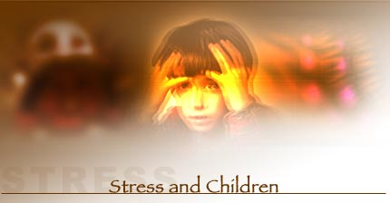
Stress engulfing the Youth
Anshul Jaiswal & A.P.Singh
Department of Psychology
AMPGC

Slide 2
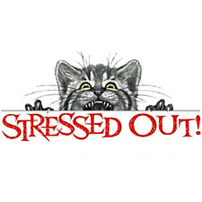
Stress - Coping With Everyday Problems
Stress is a natural part of life. The expressions are familiar to us, “I’m stressed out,” “I’m under too much stress,” or “Work is one big stress.”
Stress is hard to define because it means different things to different people; however, it’s clear that most stress is a negative feeling rather than a positive feeling.

Slide 3
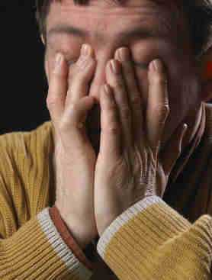
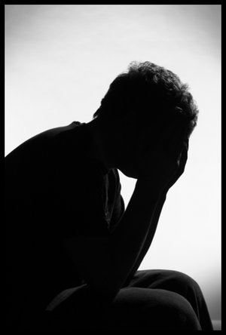
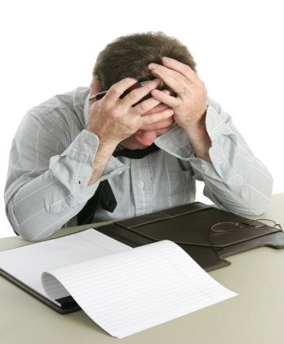
Victims of Stress
Students
Youth
Employees
Businessman
Working Women
Divorced couple
Old aged person

Slide 4
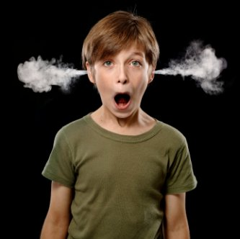
Stress among Youth
The age of adolescence is characterized by turbulence, common phases of transition — the transition here being from childhood to adulthood. It comes with its own unique challenges. There are expectations from the self and the outside world. In most cases, there is more freedom, but along with more responsibilities.
Along with biological, social and psychological changes, in our country, adolescents face challenges for the board examination. The growing mind of adolescence did not even manage to cope-up with upcoming challenges between what is right and wrong.

Slide 5
The Relationship Between Stressors and Experienced Stress
Perceptions
Stressors from the Environment
Past experience
Stress Experienced by the Person
Social Support
Individual Difference

Slide 6
Stressful event for College Students
High Stress Events
Moderate Stress Events
Low Stress Events
Death of parent
* Academic probation
* Change in
eating habits
* Change of major
Parent pressures
* Change in
sleeping habits
Unwed pregnancy
* Death of close friend
* Failing important course
* Change in social
activities
* Finding a new love interest
* Conflict with
instructor
* Loss of financial aid
* Major injury or illness
* Lower grades
than expected
* Parents’ divorce
* Serious arguments with
romantic partner
* Outstanding achievement

Slide 7
Negative Stress
Negative stress is generally seen harming
ones social, and psychological life and is characterized by its contributory factors such as headaches, digestive problems, skin complaints, insomnia and ulcers.
Excessive, prolonged and unrelieved stress can have a harmful effect on mental, physical and spiritual health.

Slide 8
Positive Stress
Stress can also have a positive effect, spurring motivation and awareness, providing the stimulation to cope with challenging situations.
Stress also provides the sense of urgency and alertness needed for survival when confronting threatening situations

Slide 9
Consequences of Stress
Physiological effects
Increased blood pressure, increased heart rate, sweating, hot and cold spells, etc.
Emotional effects
Anger, anxiety, depression, lowered self-esteem, etc.
Behavioral effects
Poor performance, absenteeism, fighting among friends, irritating response etc.

Slide 10
Managing Stress
Remember that success will not come from a half hearted effort, nor will it come overnight. It will take determination, persistence and time. Some suggestions may help immediately, but if the stress is chronic, it may require more attention and lifestyle changes. Determine the tolerance level for stress and try to live within the limits. Learn to accept or change stressful and tense situations whenever possible.

Slide 11
Individual Stress Management Initiatives
Designed to eliminate or control sources of stress and improve the person’s ability to cope
A person can manage stress by:
Planning ahead and practicing good time management
Having good personal health management practices
Maintaining a positive perspective
Balancing work life and personal life
Learning a relaxation technique

Slide 12
Combating Stress
ABC of stress
A= Awareness. “what cause you stress”
B= Balance “ between positive and negative stress”
C= Control “ what one can do to help themselves”

Slide 13
Stress-busters
During times of stress, certain factors may help deal with it. Some such stress-relievers are:
Exercising, walking, running, aerobics
Playing indoor/outdoor games
Shouting or crying or laughing out aloud
Doing a favourite hobby like singing, dancing, listening to music, Meditating, doing yoga
Keeping pets, looking at a fish tank
Watching the sea
Sleeping
Going to temples or churches or mosques, praying
Drawing, painting, looking at calming scenes like green fields

Slide 14
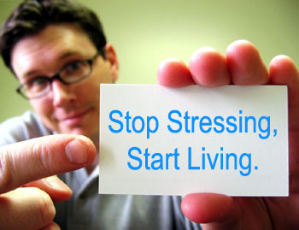
Conclusion
Knowing Stress is itself a solution to “Stress’’
“Don’t think about past it brings Sorrow
Don’t think about future if brings Tension
Think for the present it brings Happiness”

Slide 15
Thank you

